Slide 1
Whitefish Mountain Resort

Slide 2
Problem
Recently increased costs from new chair lift installment
Operating costs are now at $1.54 million
Business profit margin is at risk

Slide 3
What do we need to do?
Maintain business profit at 9.2%+
2 Options: Raise Prices or Decrease Costs

Slide 4
Recommendation
Raise our price point to $89

Slide 5
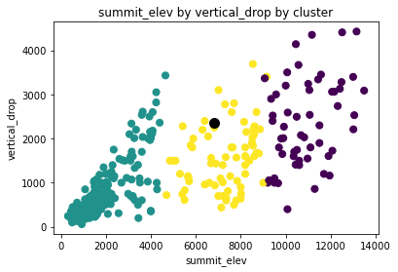
Analysis
Whitefish Mountain resort lies squarely in the middle of the pack in size

Slide 6
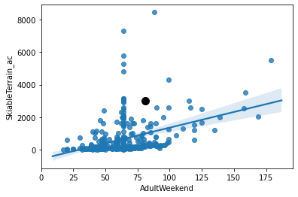
Analysis
Yet, we are on the lower end of the price spectrum for a ski resort of our size

Slide 7
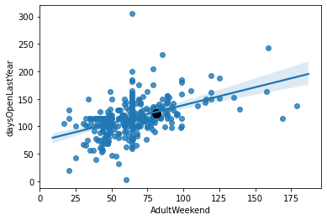
Analysis
We are right on the line when comparing similar time spent open

Slide 8
Conclusion
Reasonably, we can raise our price and be within the market range
We’ll be able to increase our revenue by $2,450,000
Subtracting the overhead costs: Net profit of $910,000

